Slide 1

Pity Me,
I Play Genshin Impact
Anupam Bhakta, Oliver Smirnov, & Kevin Qiu

Slide 2
What is Genshin Impact?
Genshin Impact is an open world MMORPG game developed by miHoYo
Genshin has a special loot box system called wishes
Players can spend either in-game currency or real money for the chance of getting a new character or weapon
Characters and weapons are ranked from 1 (worst) to 5 (best) stars
The best characters on average, require more rolls to obtain

Slide 3

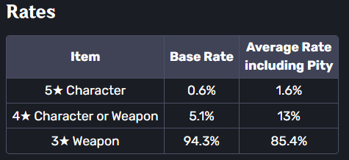
The Pity System
To prevent player overspending, Genshin Impact features a pity system
The more a player spends without getting a rare character, the more likely they will get a rare character

Slide 4
Our Questions
Does the pity system work as miHoYo claims?
How does the pity system evolve as the number of unsatisfactory rolls increases?

Slide 5
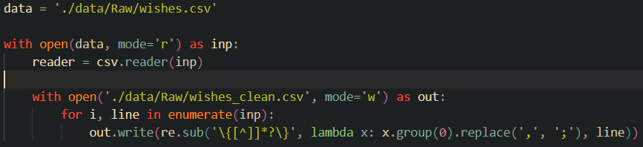
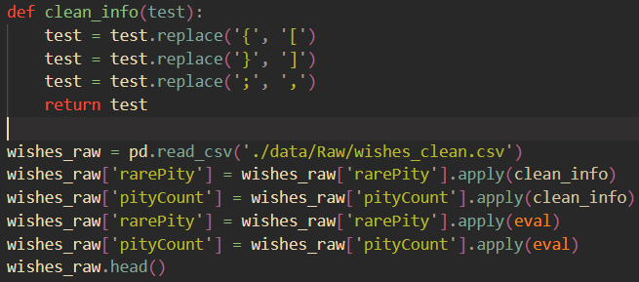
Data Cleaning
Most of data was easily read
pulls.csv
wish_total.csv
wishes.csv
Included list values in cells that used the same delimiters
Had to change delimiters and parse strings into list objects

Slide 6
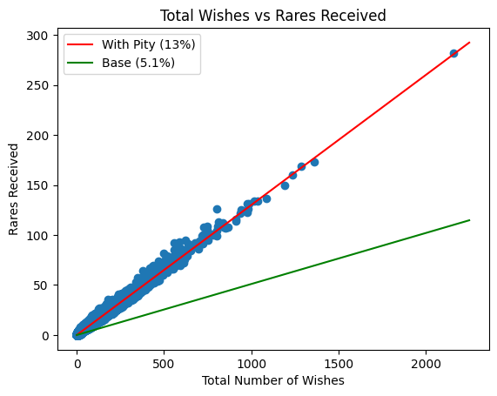
Initial Observations (Rare)
There is a clear linear relationship between the total number of wishes and the number of rares received.
Data fits nicely with given pull percent for rares.
There are more rares received than expected because players stop pulling when they get what they want.
R² = 0.9783

Slide 7
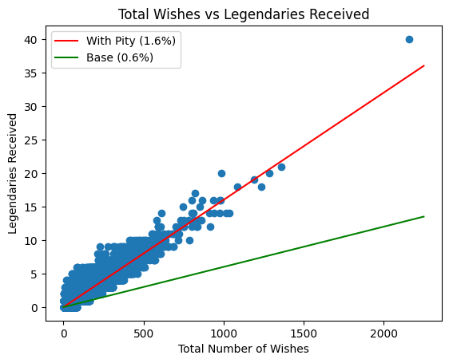
Initial Observations (Legendary)
There is once again a clear linear relationship.
Data fits nicely with given pull percent for legendaries.
There are more legendaries received than expected because players stop pulling when they get what they want.
Higher spread is attributed to scarcity of legendary pulls. Players are also more likely to stop pulling after getting a legendary than after getting a rare.
R² = 0.7177

Slide 8
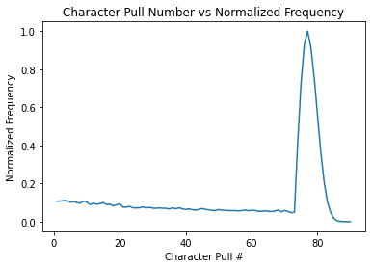
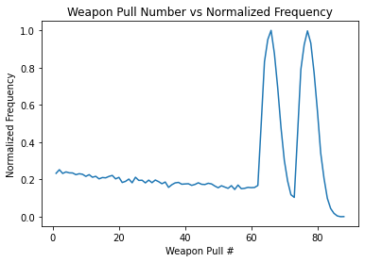
Looking Closer at Pull # vs Frequencies of Legendaries

Slide 9
Further Analysis of Pity

Slide 10
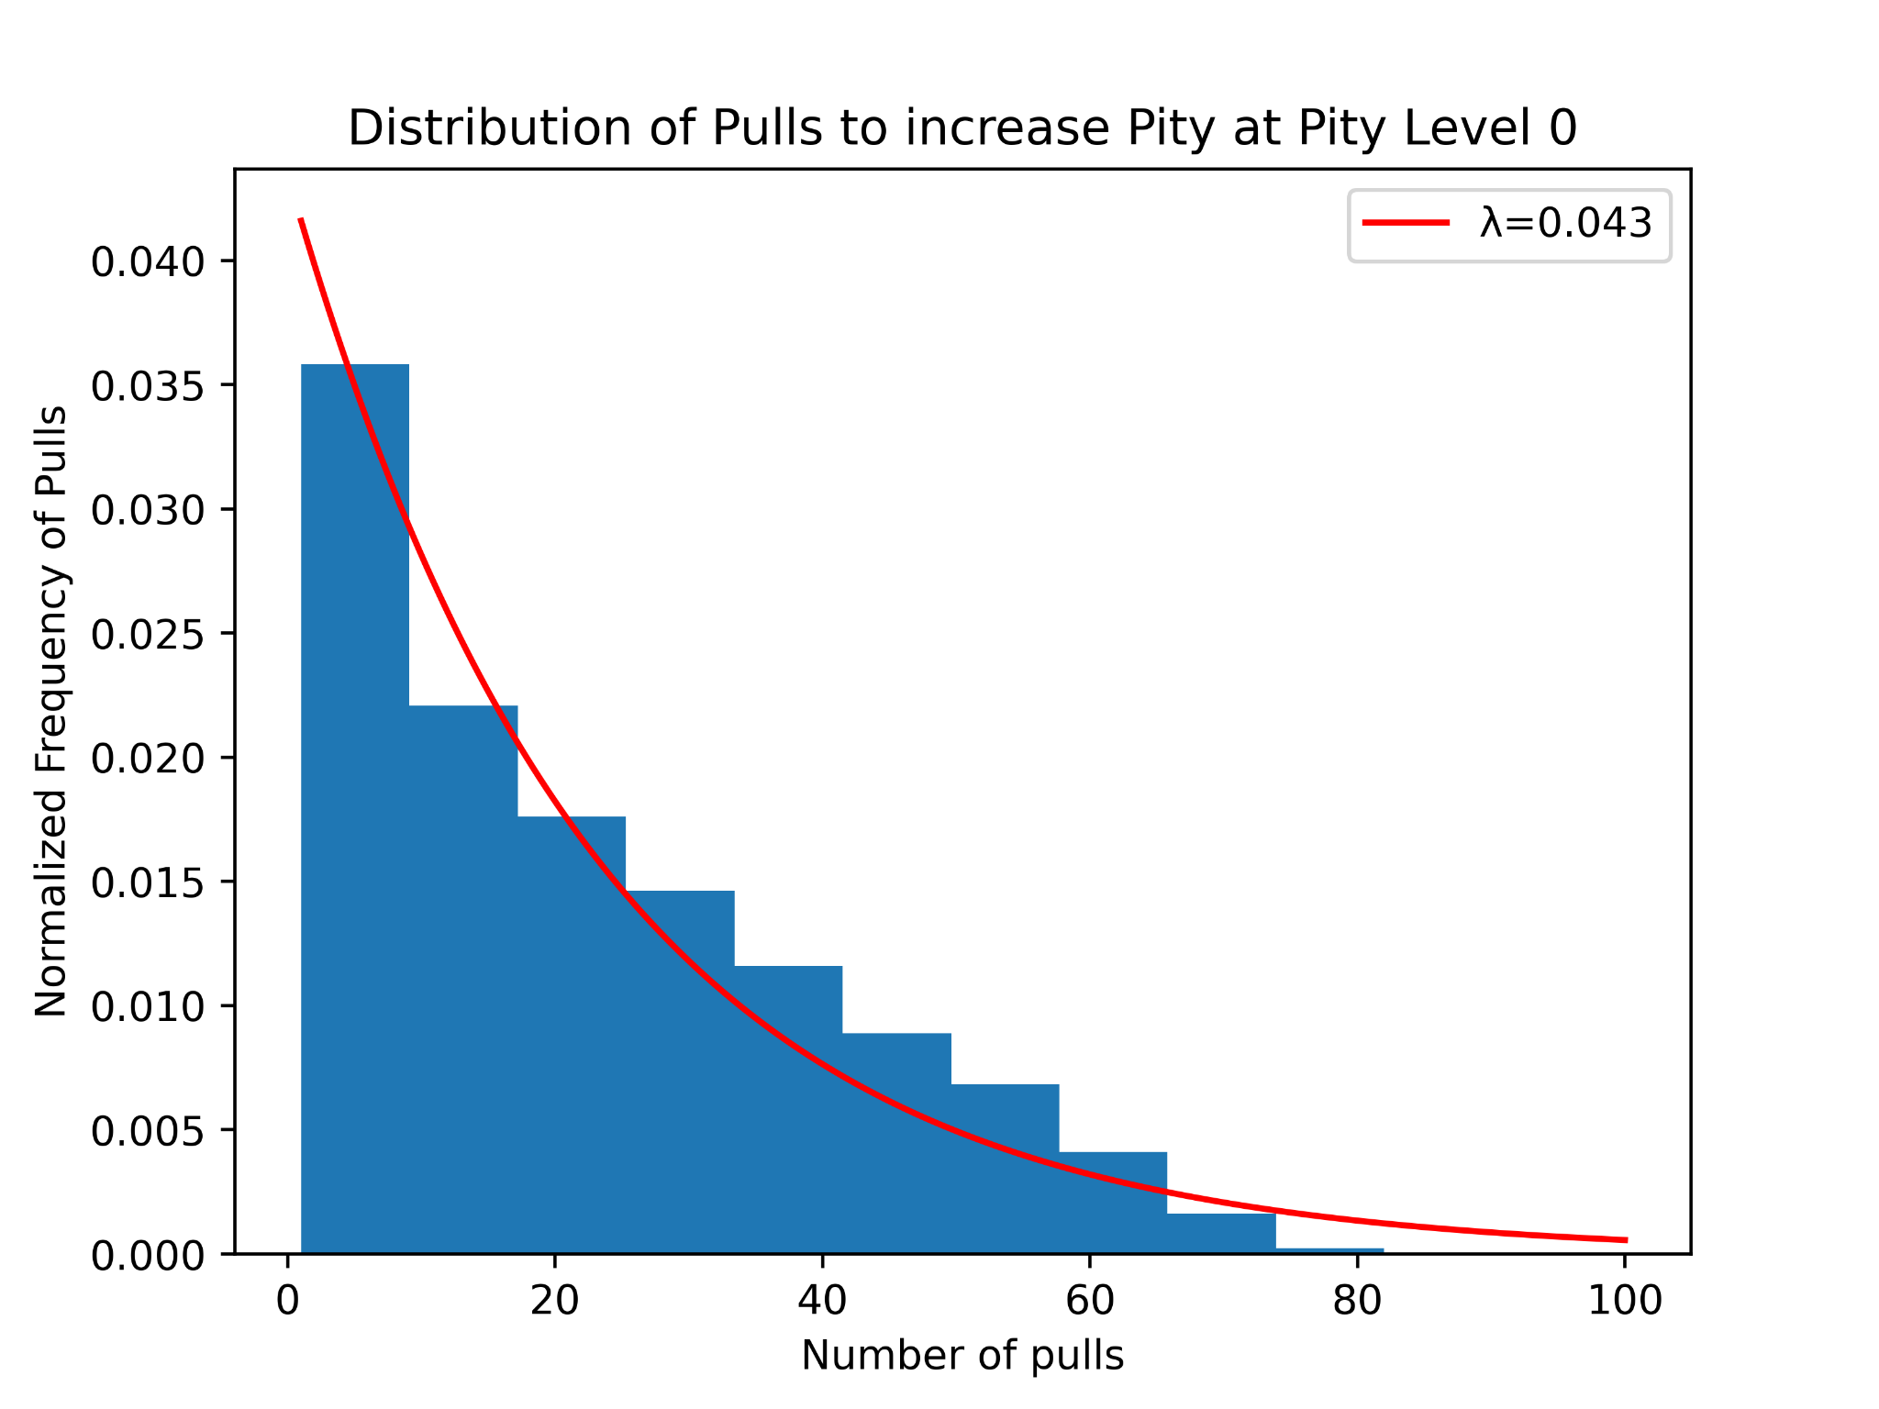
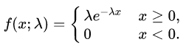
I. Pulls Needed to Increase Pity Level at Given Pity Levels
Exponential Distribution PDF

Slide 11
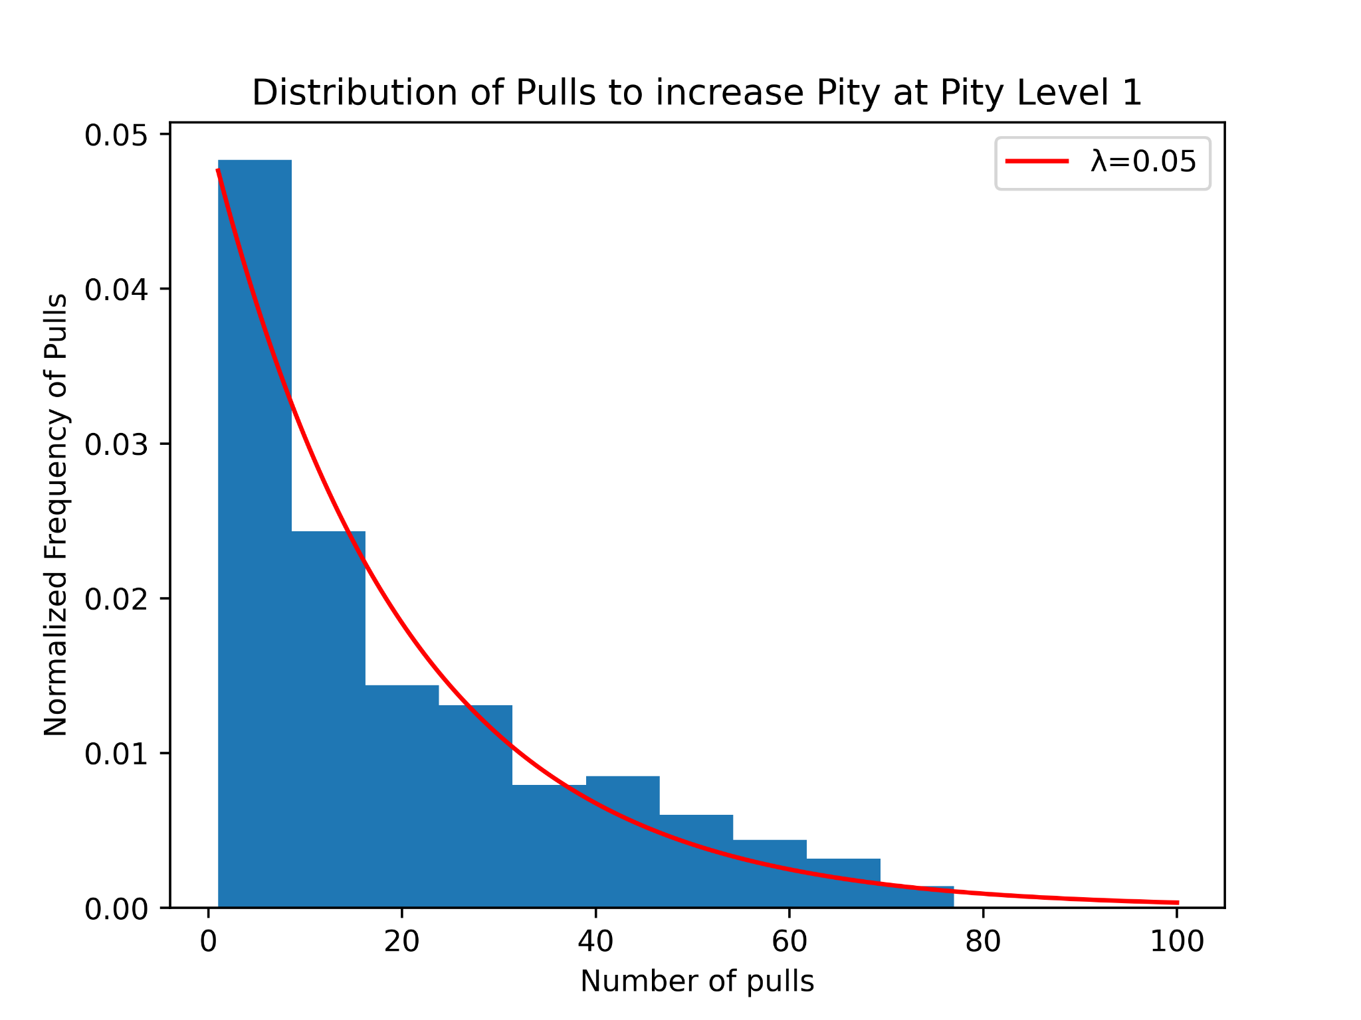
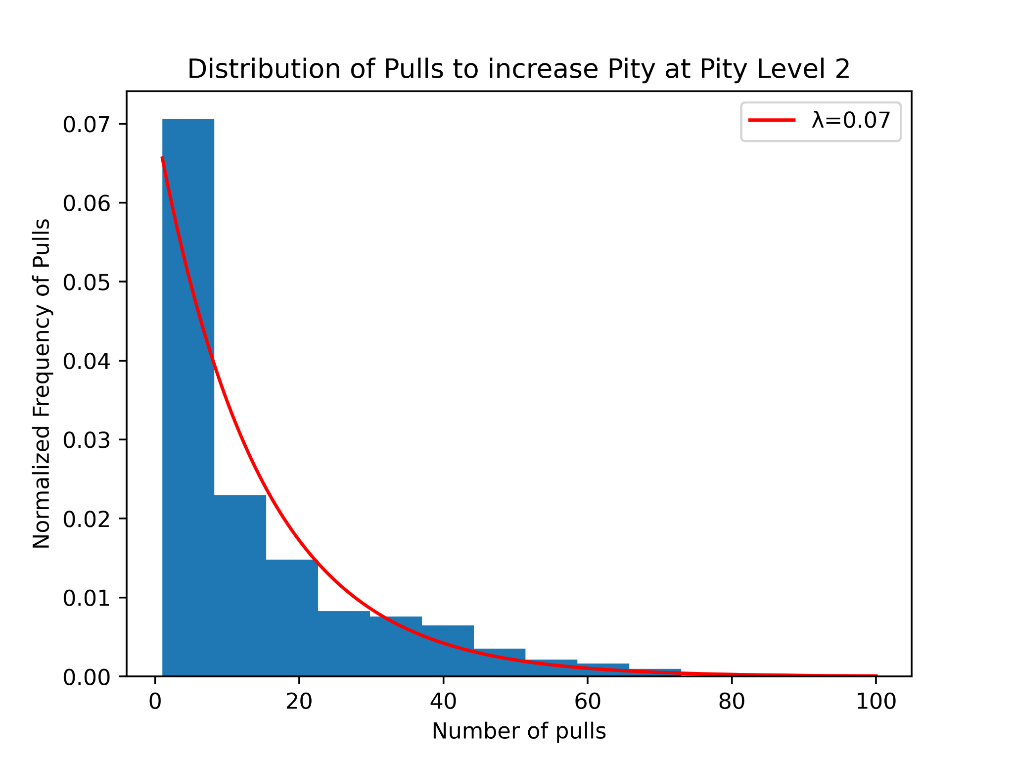
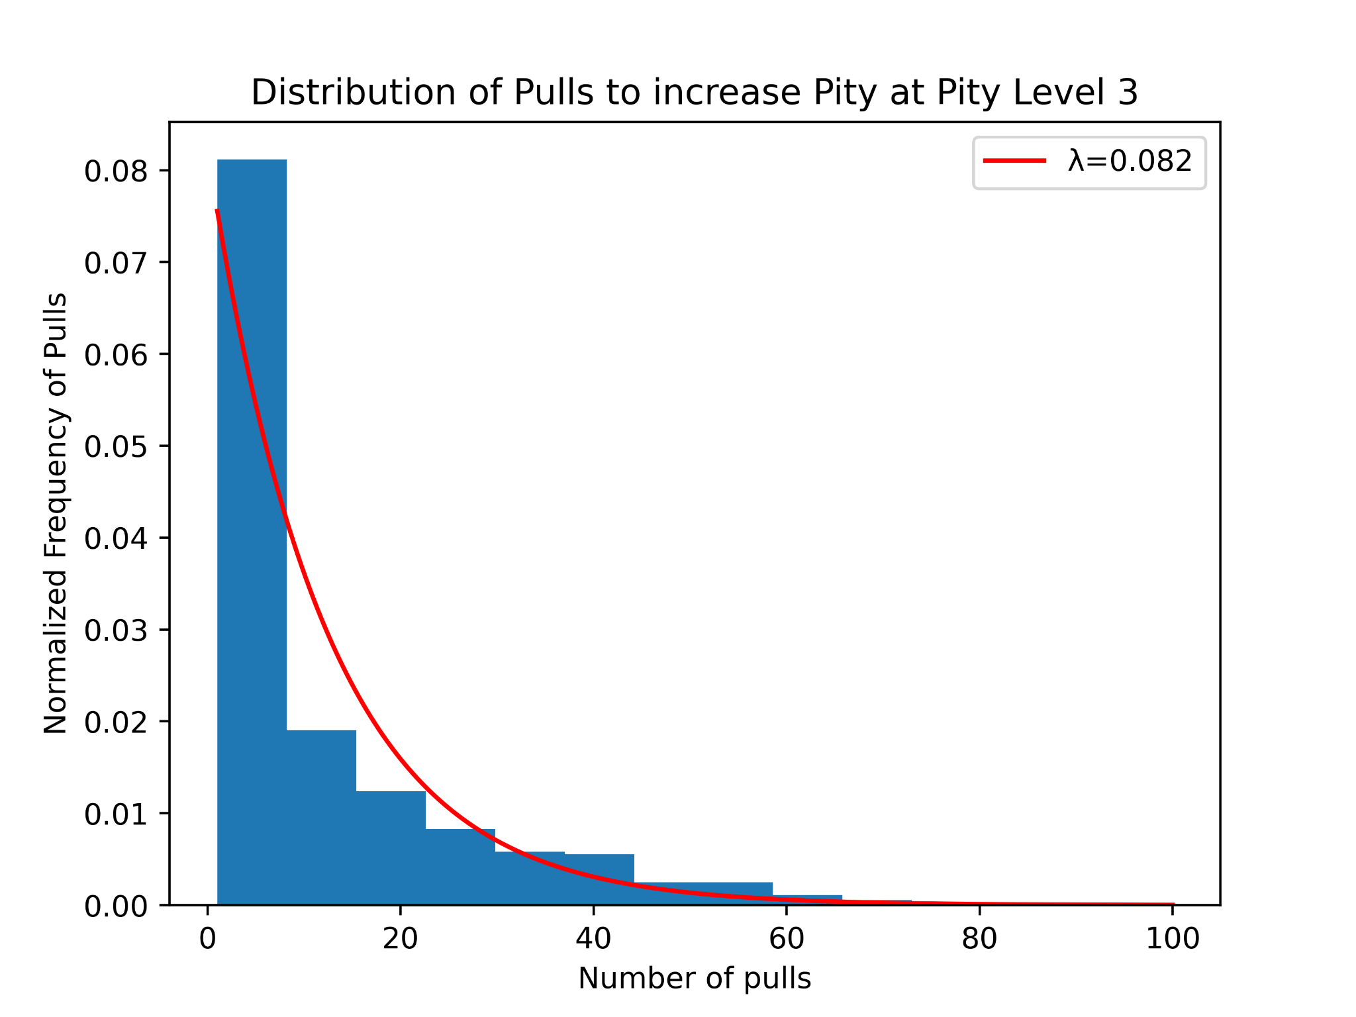
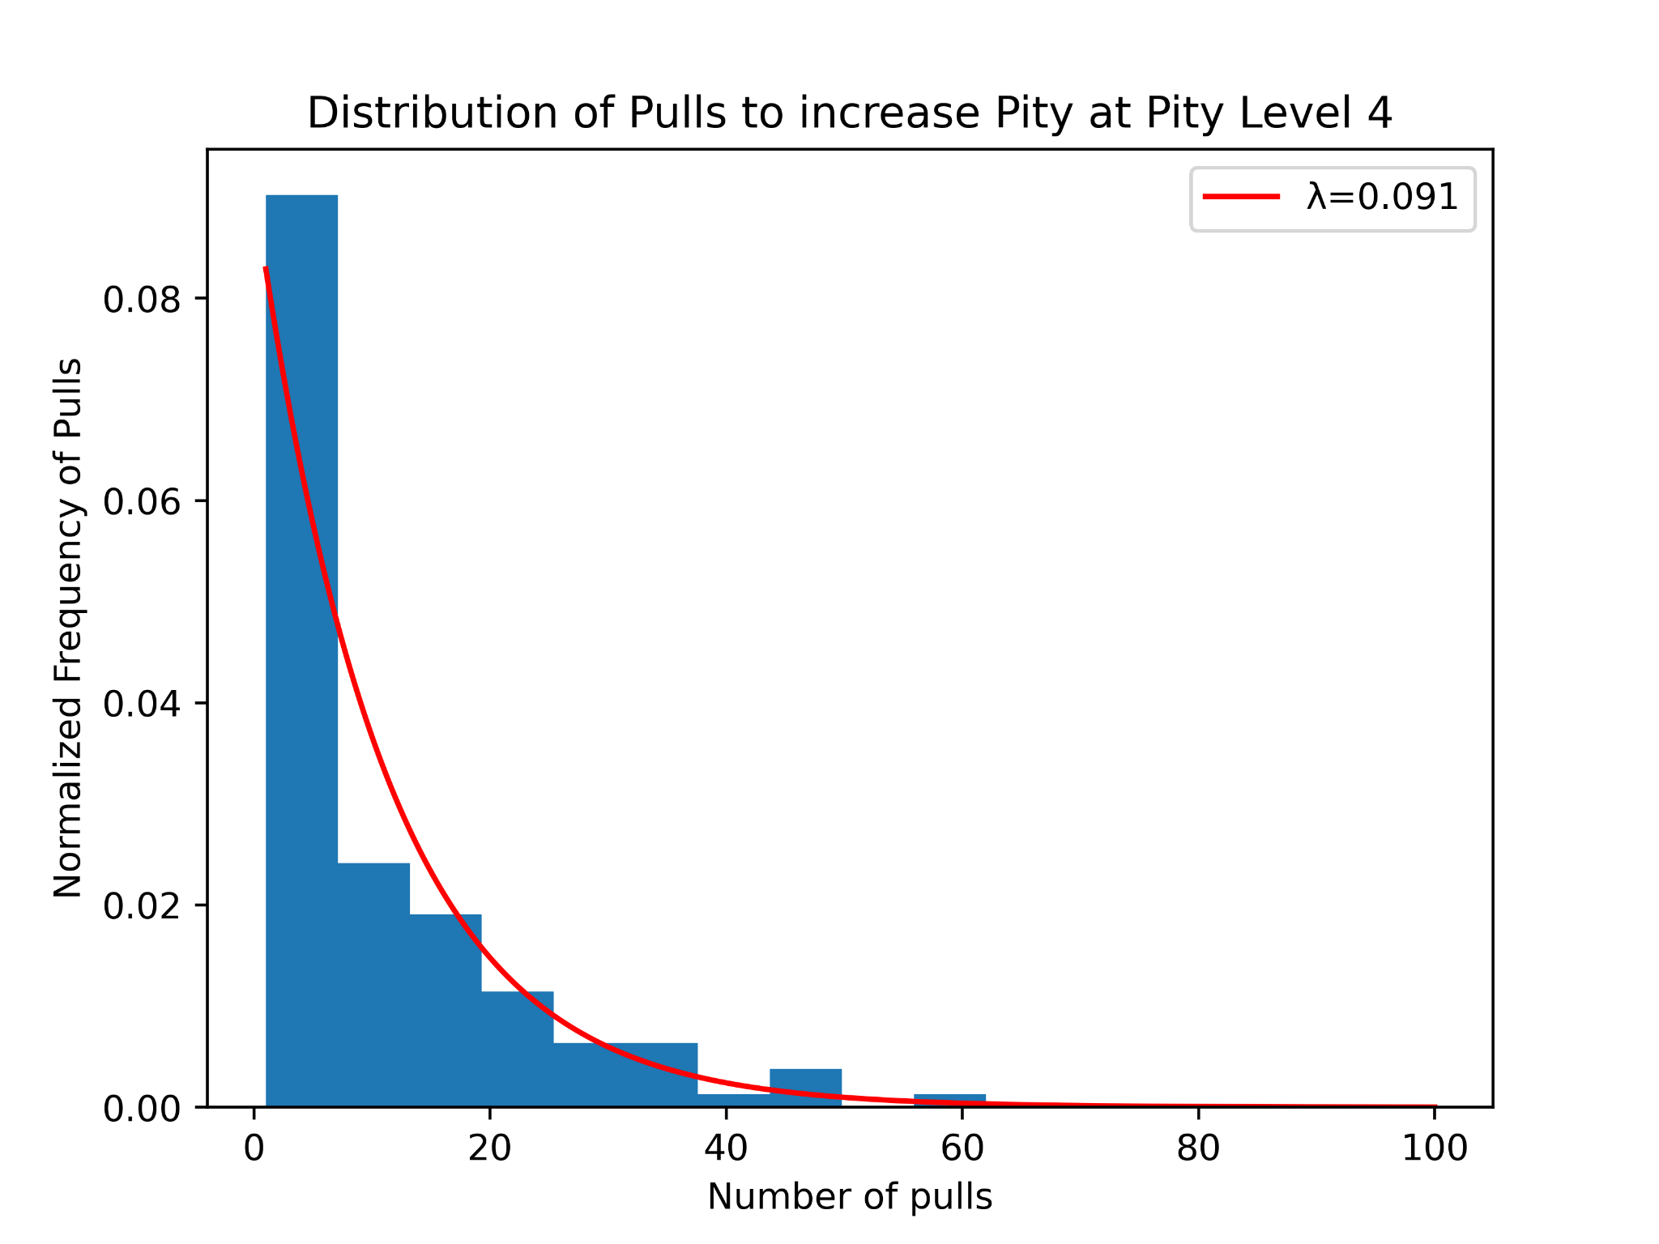
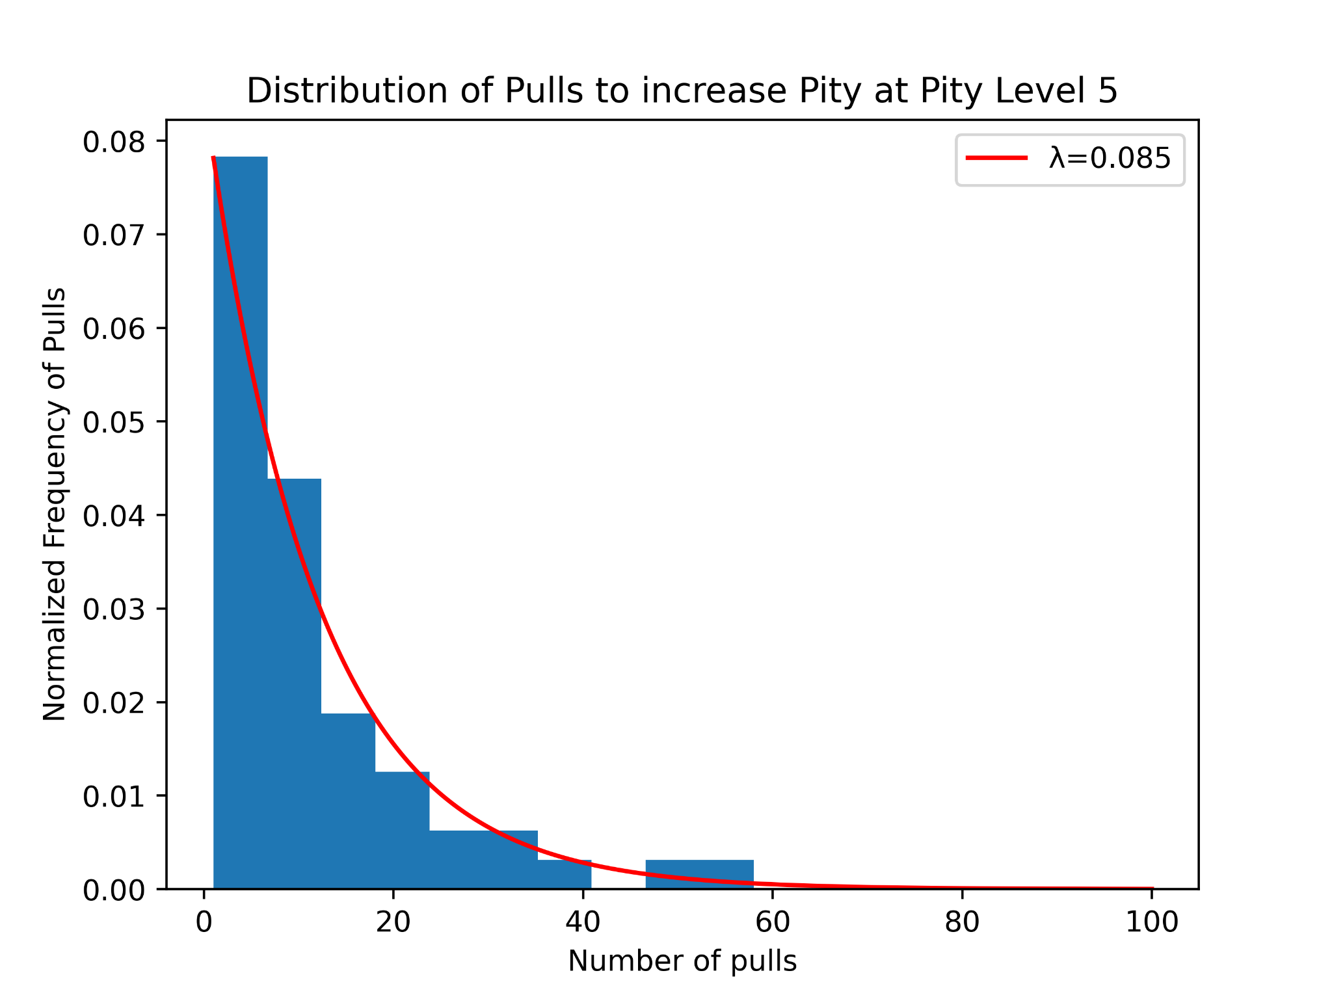
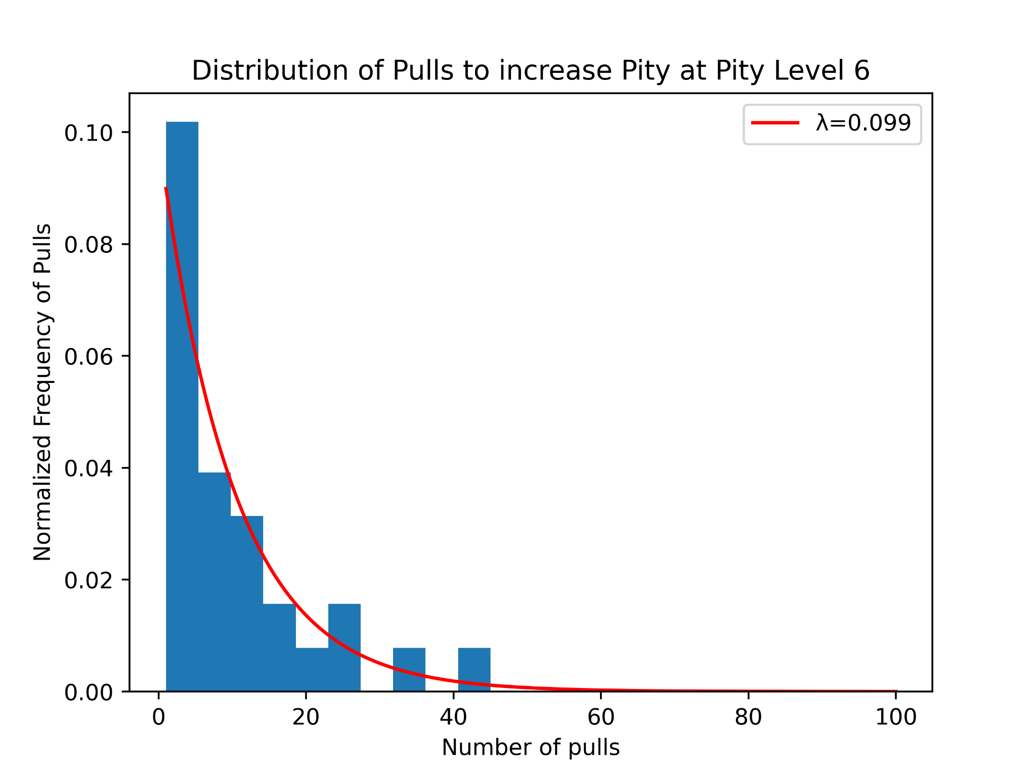
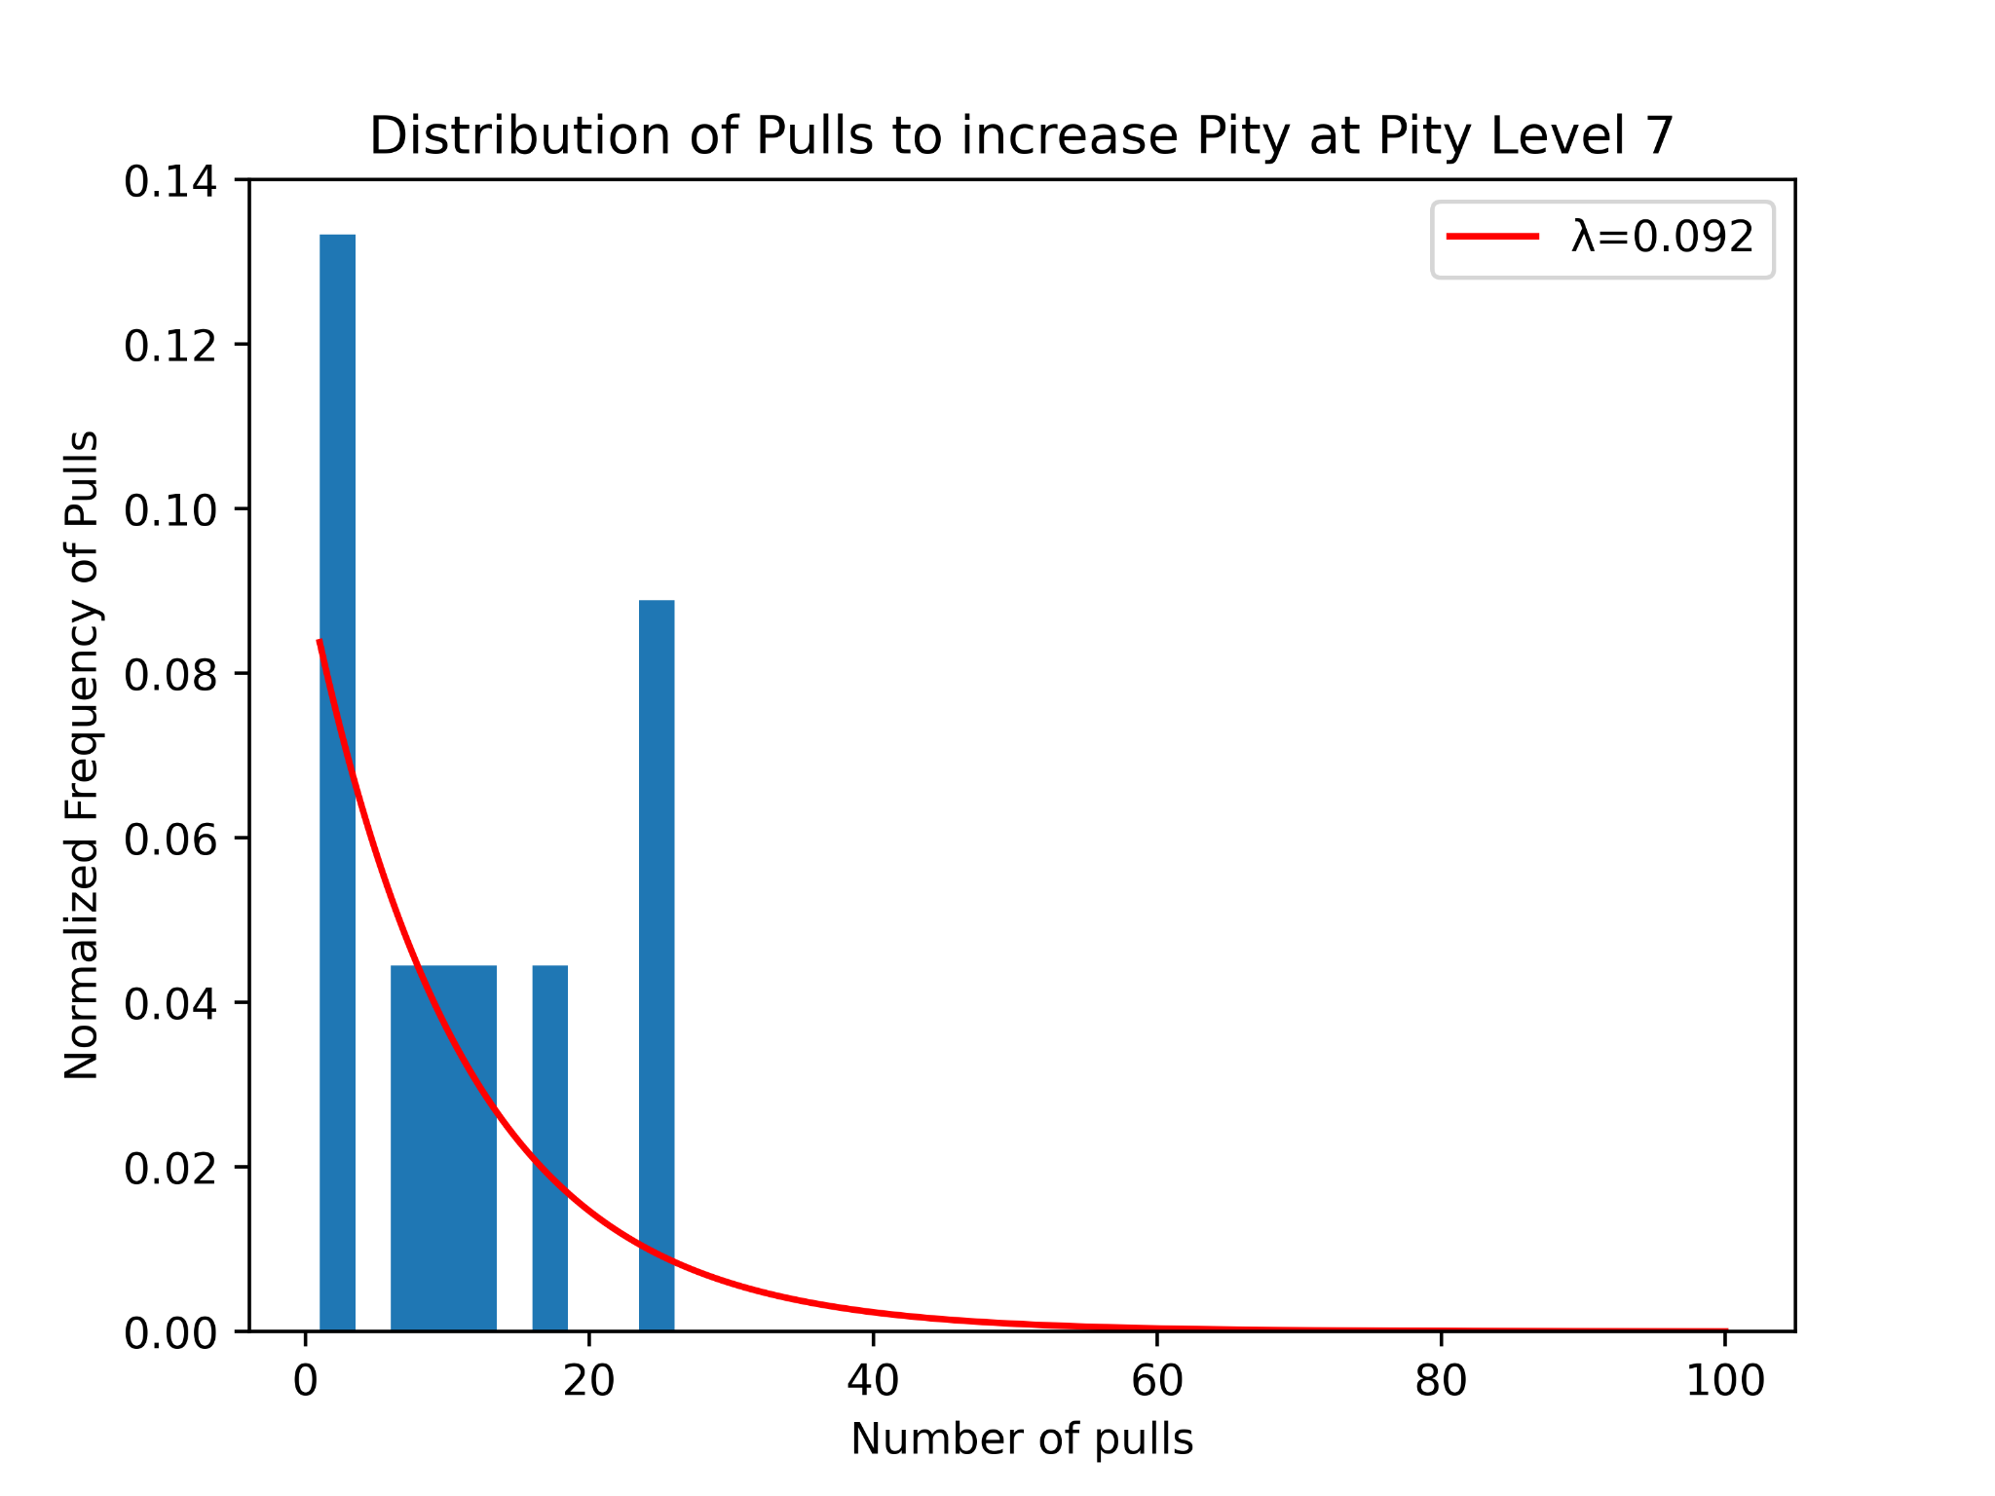
Pulls Needed to Increase Pity Level at Given Pity Levels

Slide 12
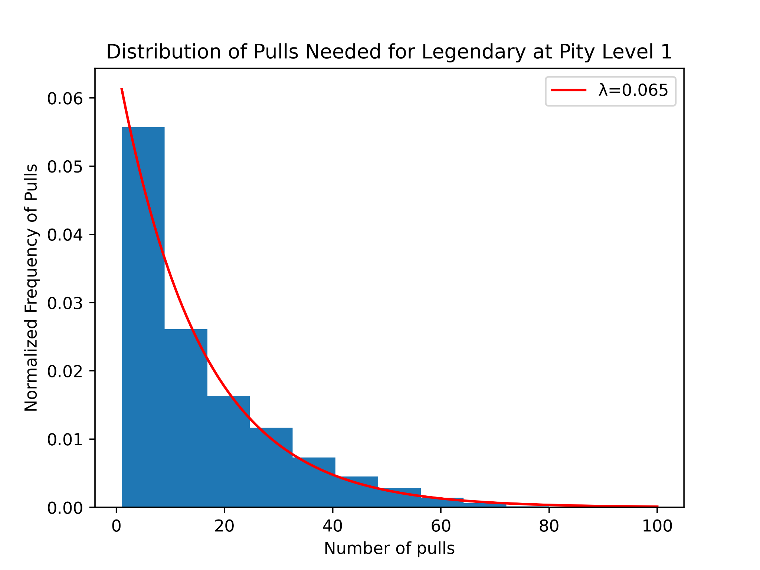
II. Pulls Needed for Legendary at Given Pity Levels
Exponential Distribution PDF

Slide 13
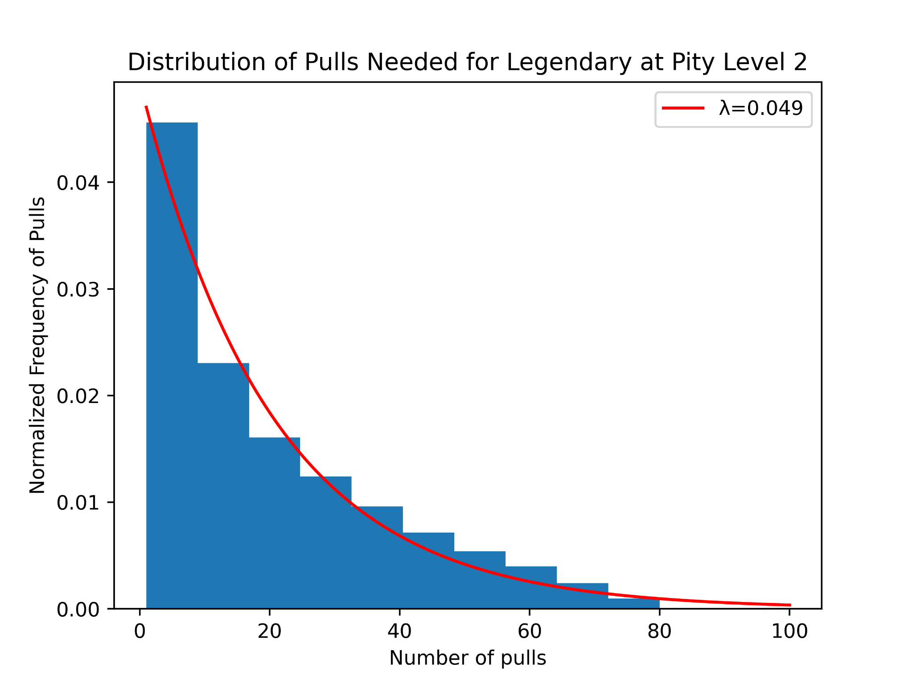
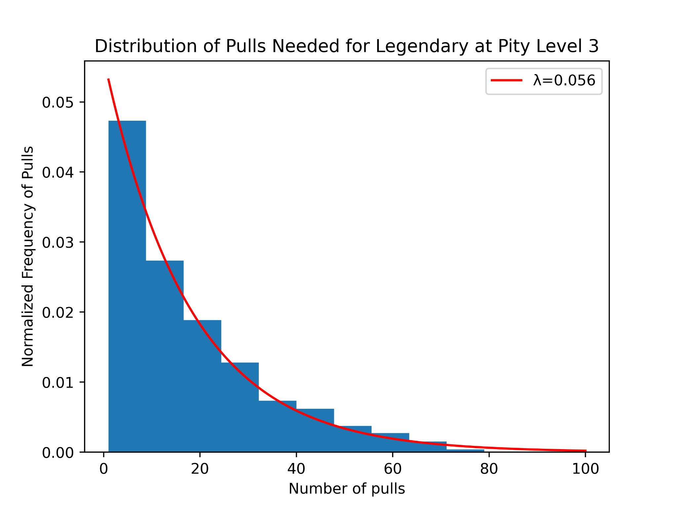
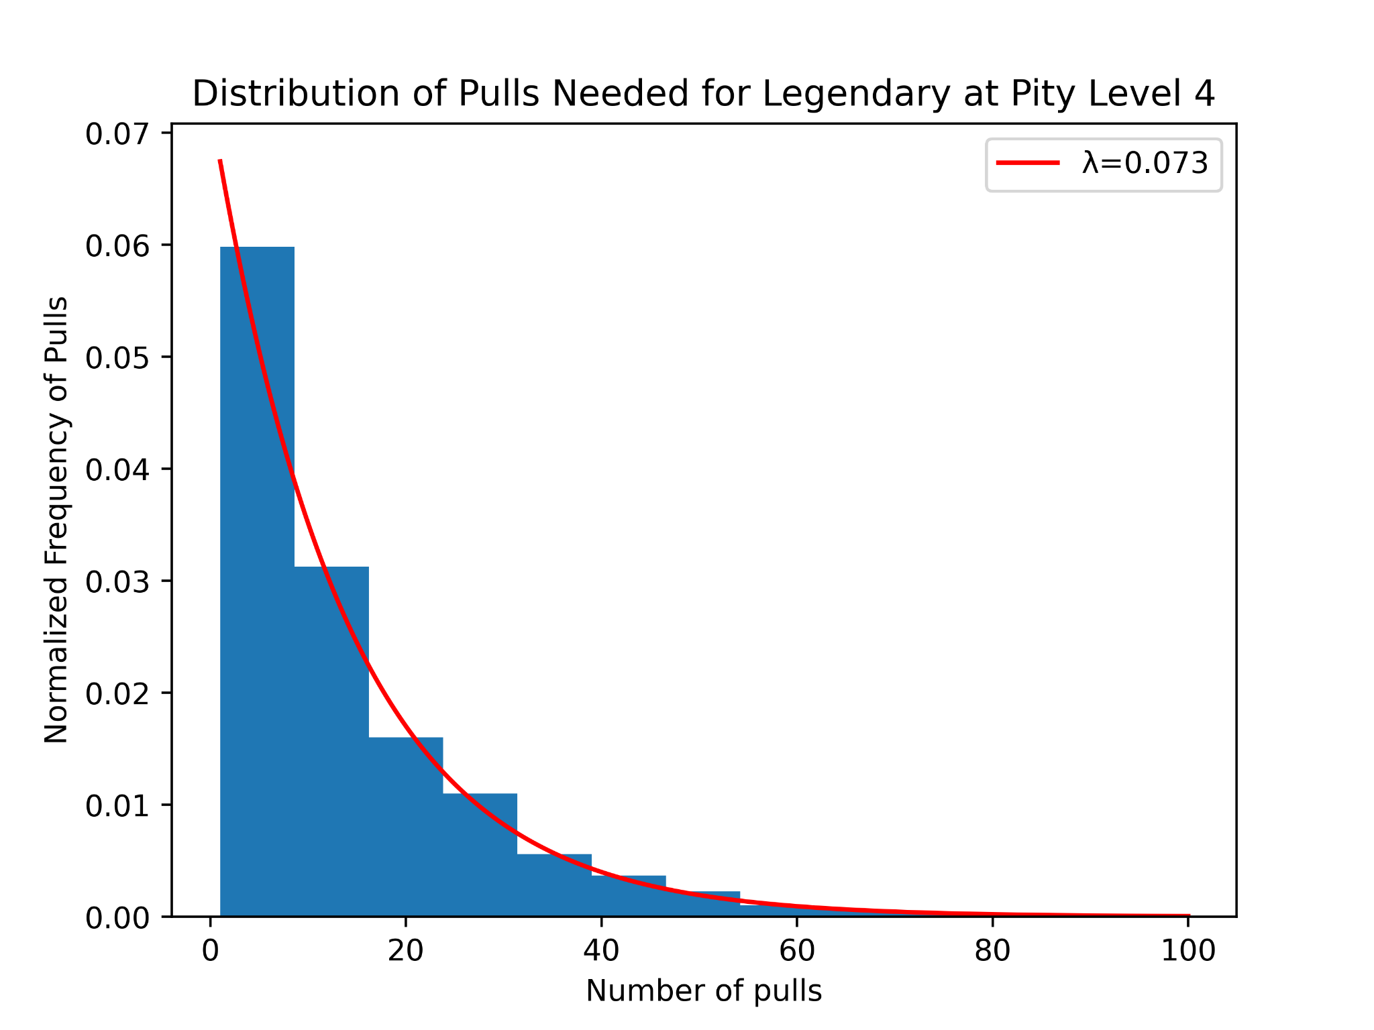
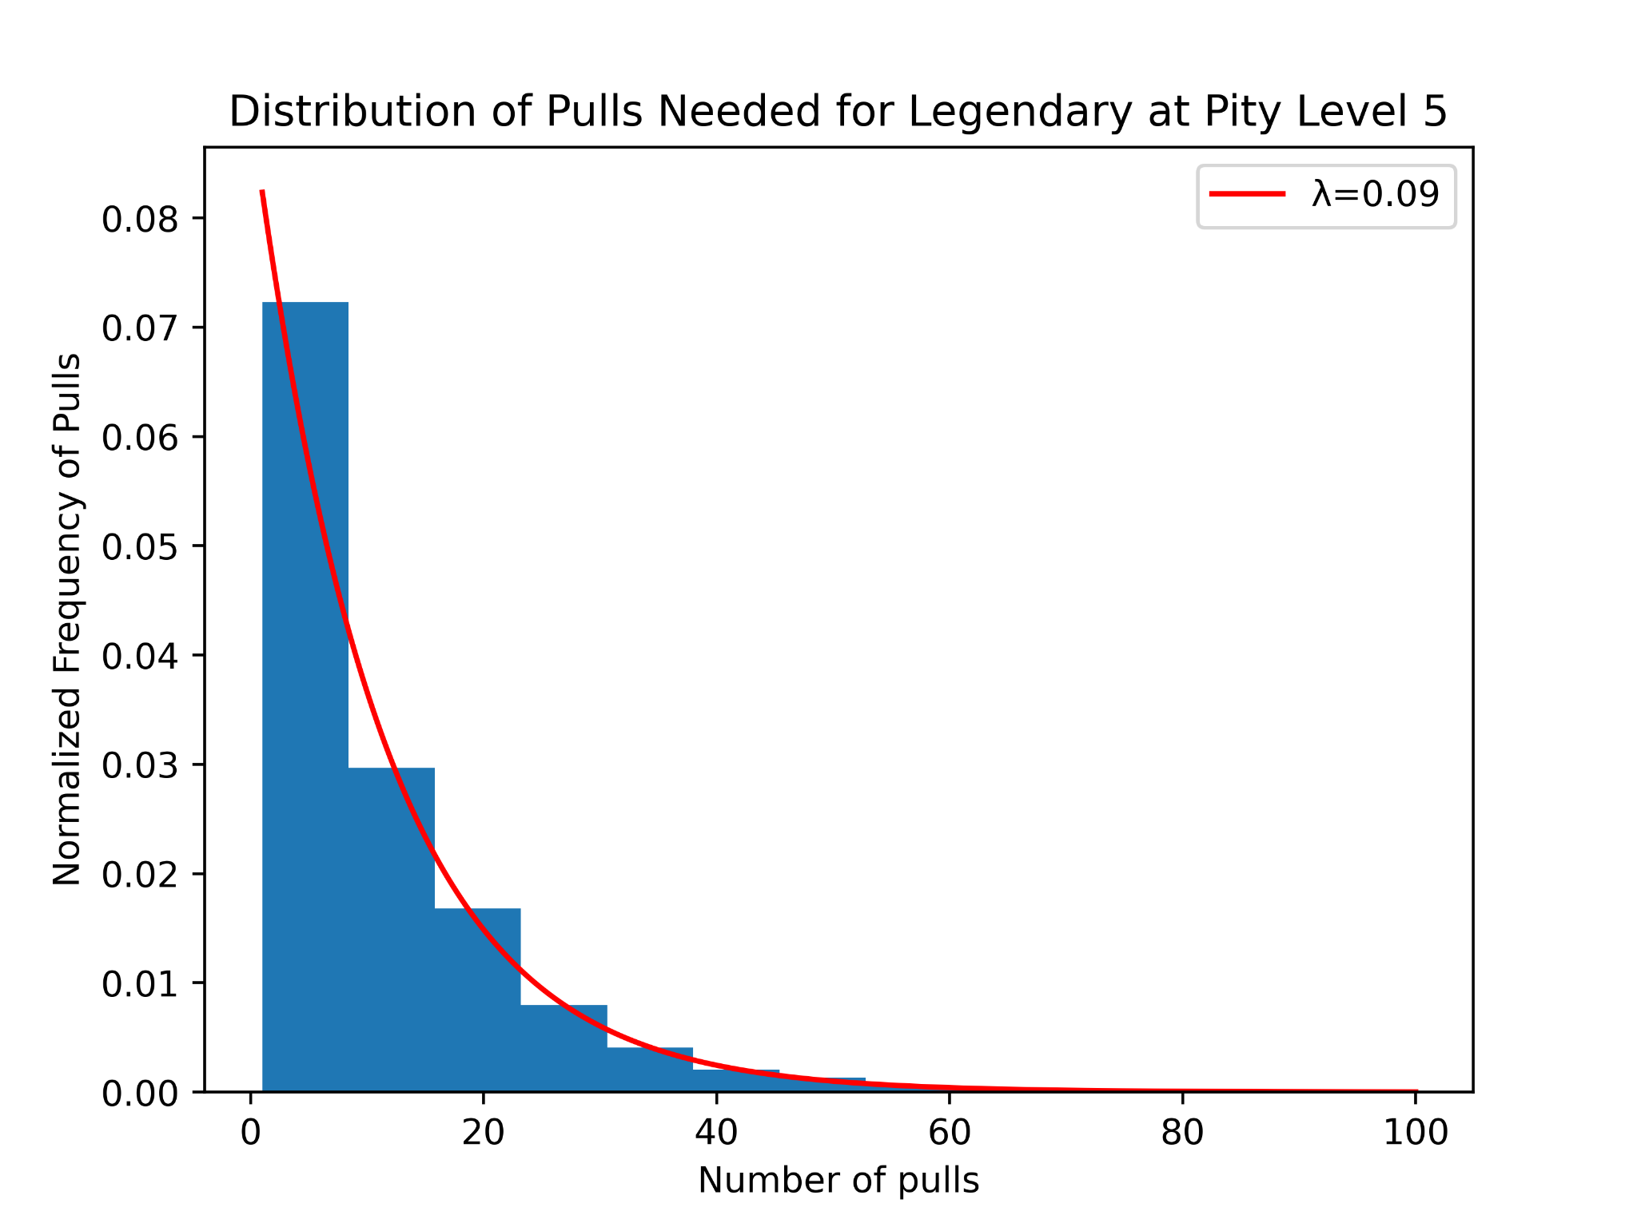
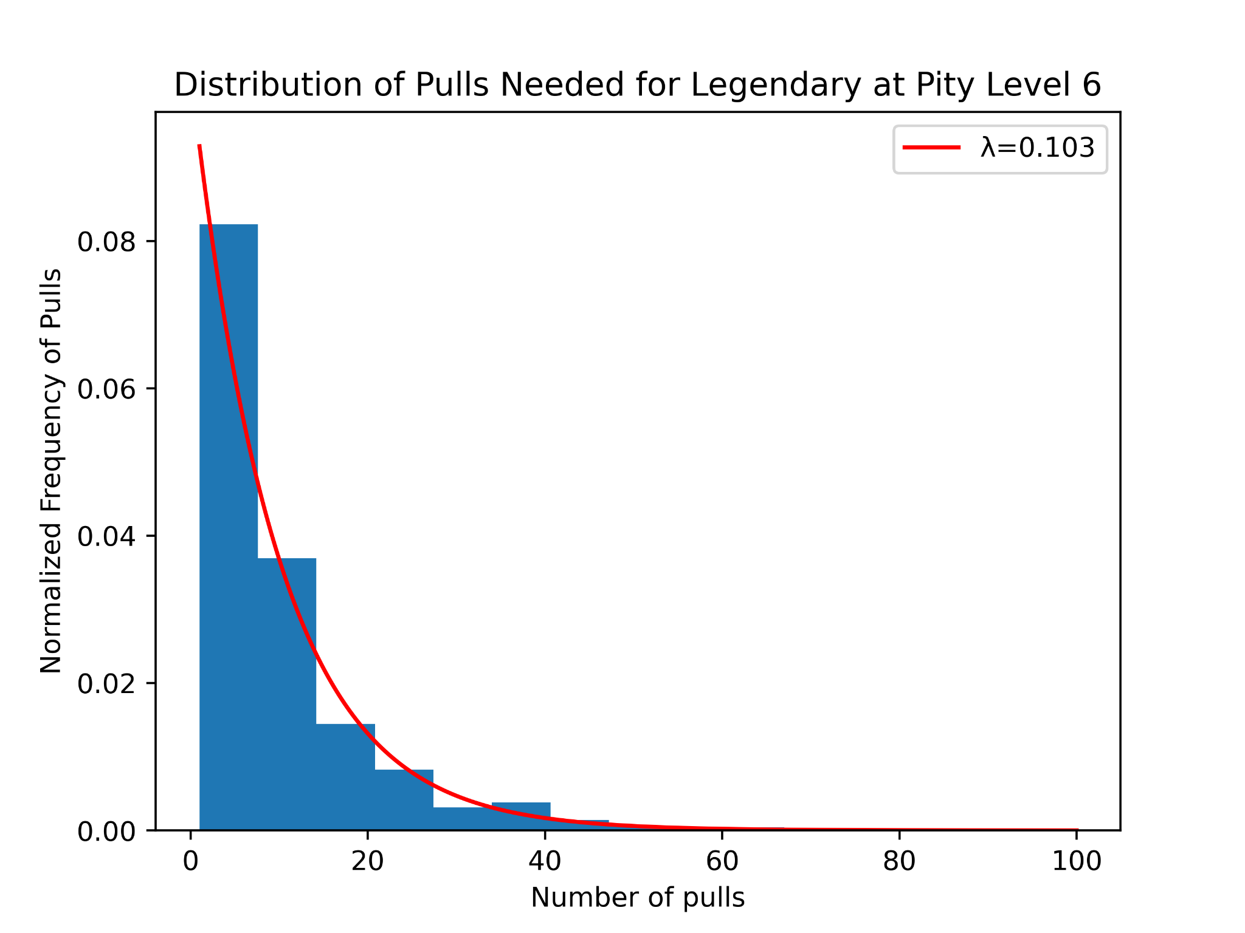

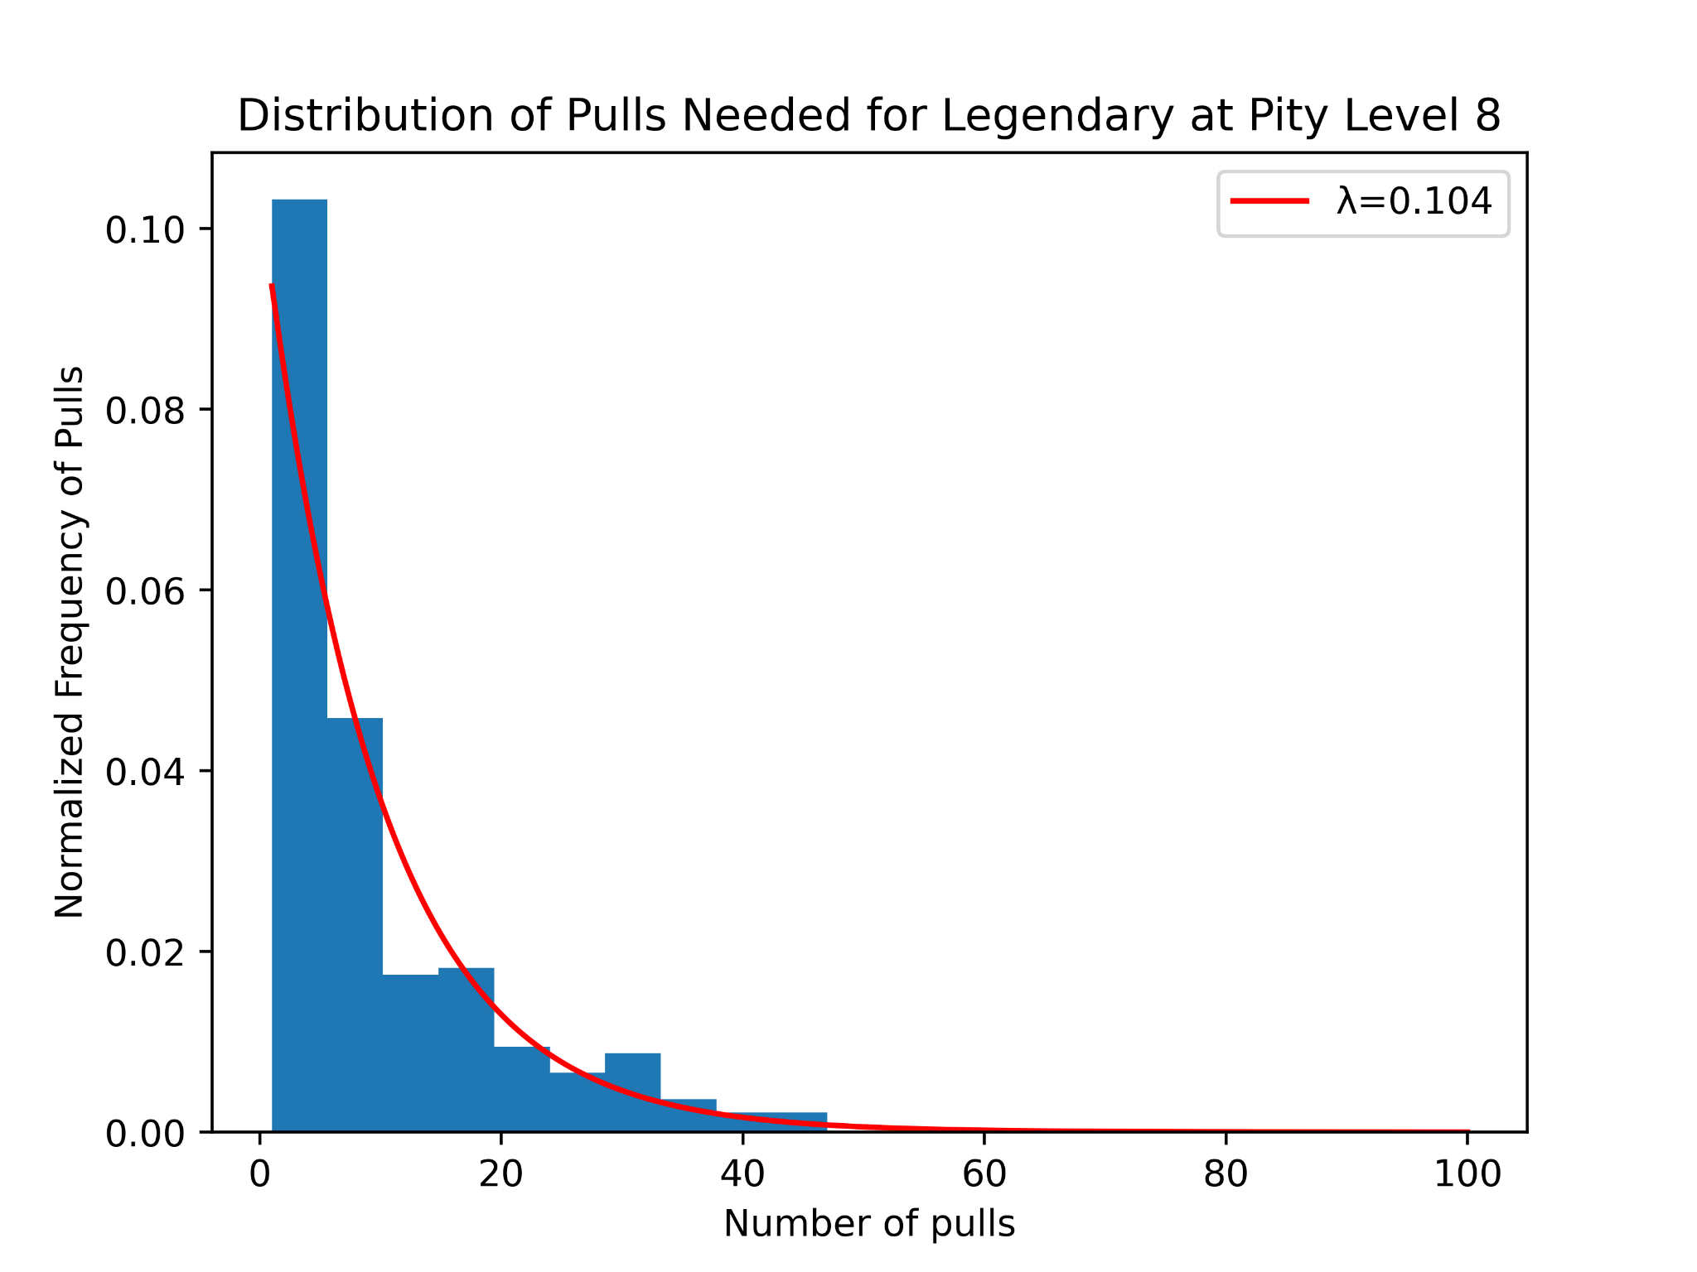
Pulls Needed for Legendary at Given Pity Levels

Slide 14
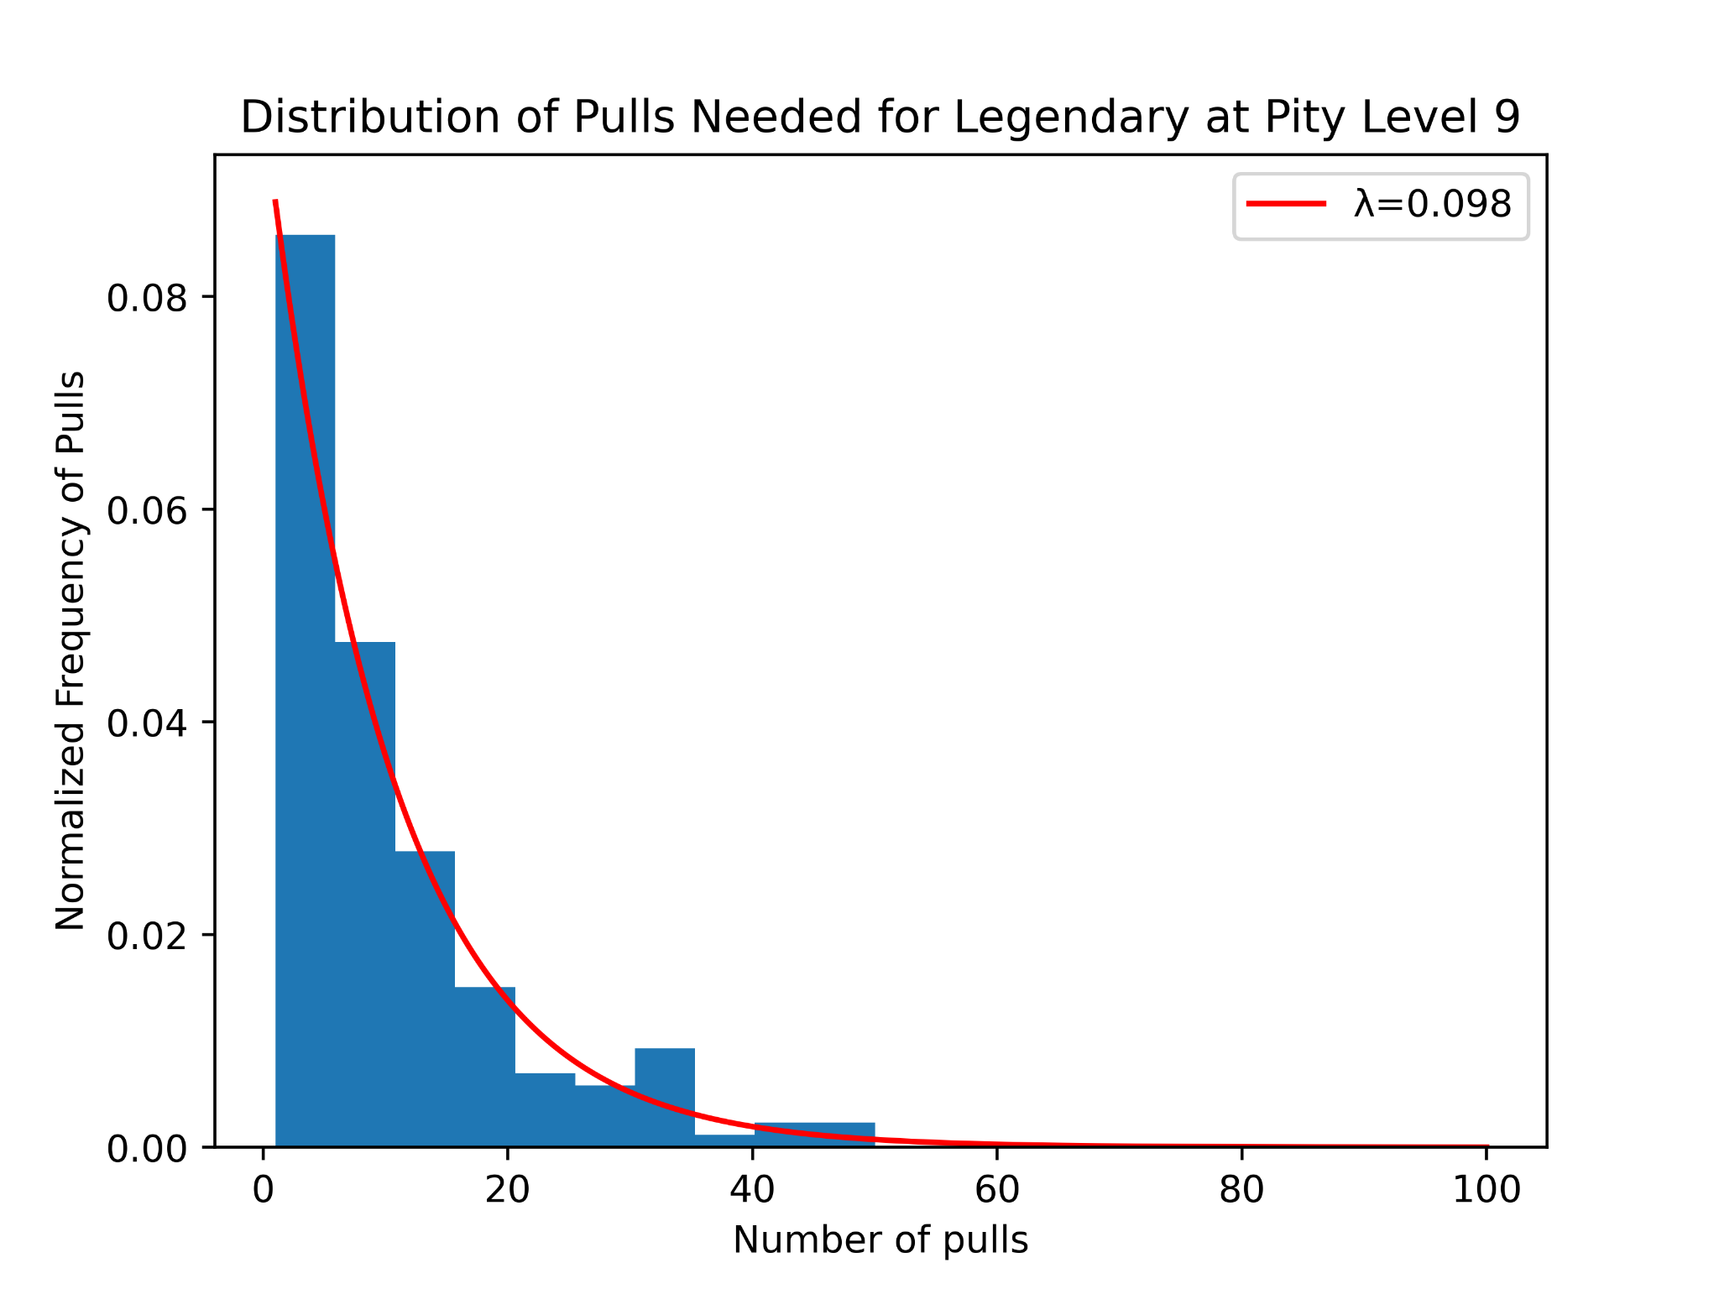

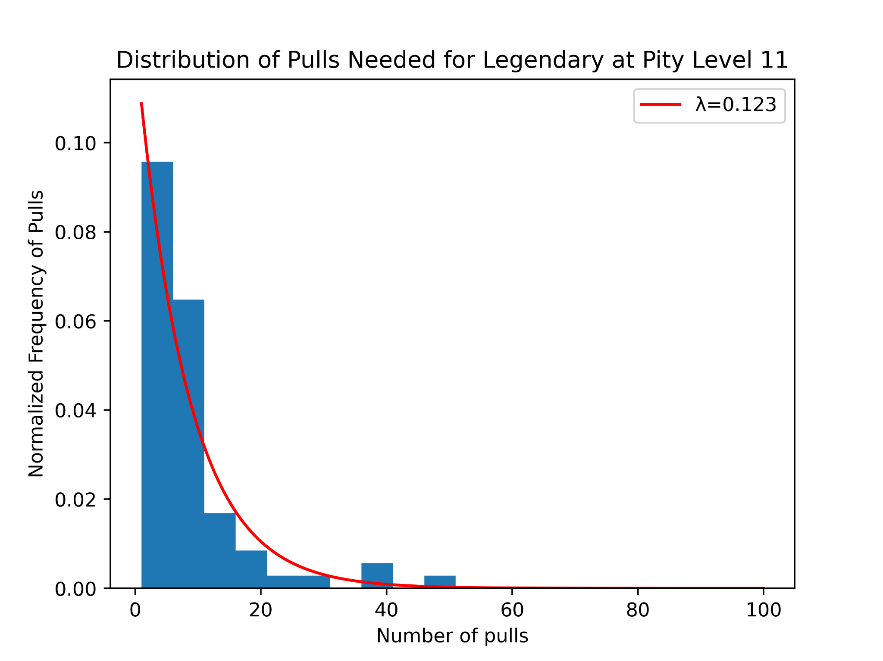
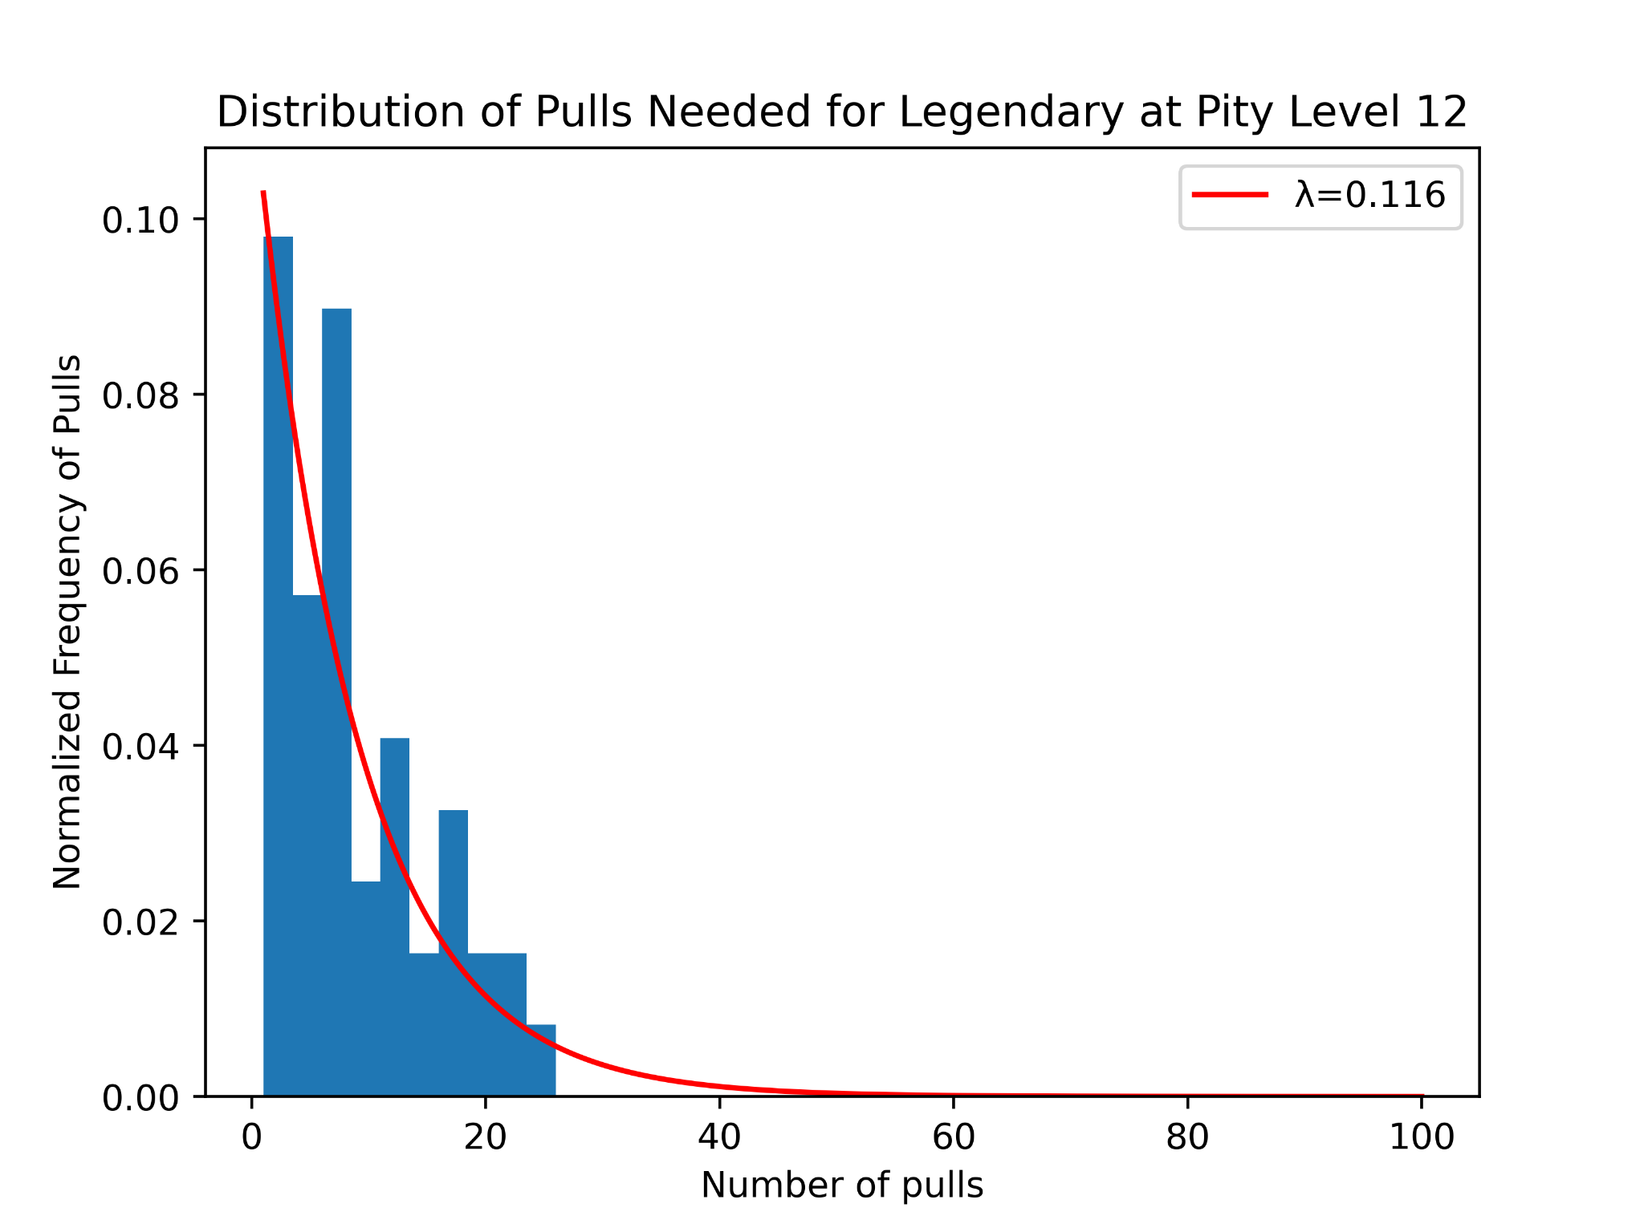
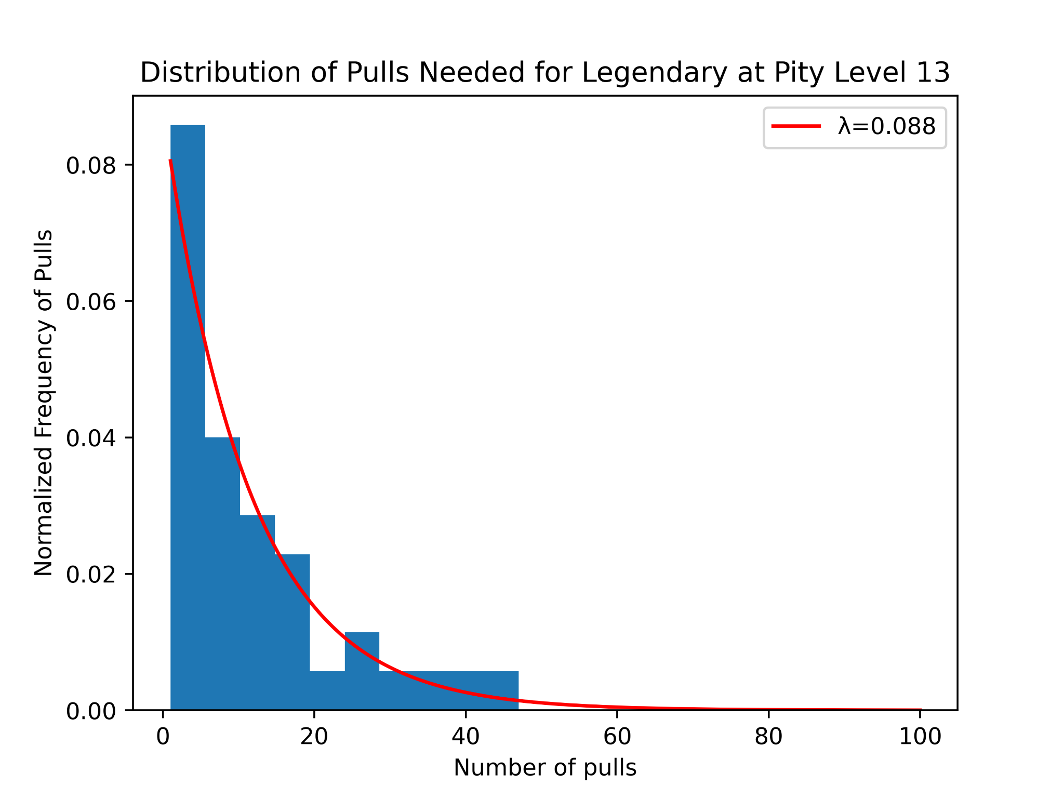
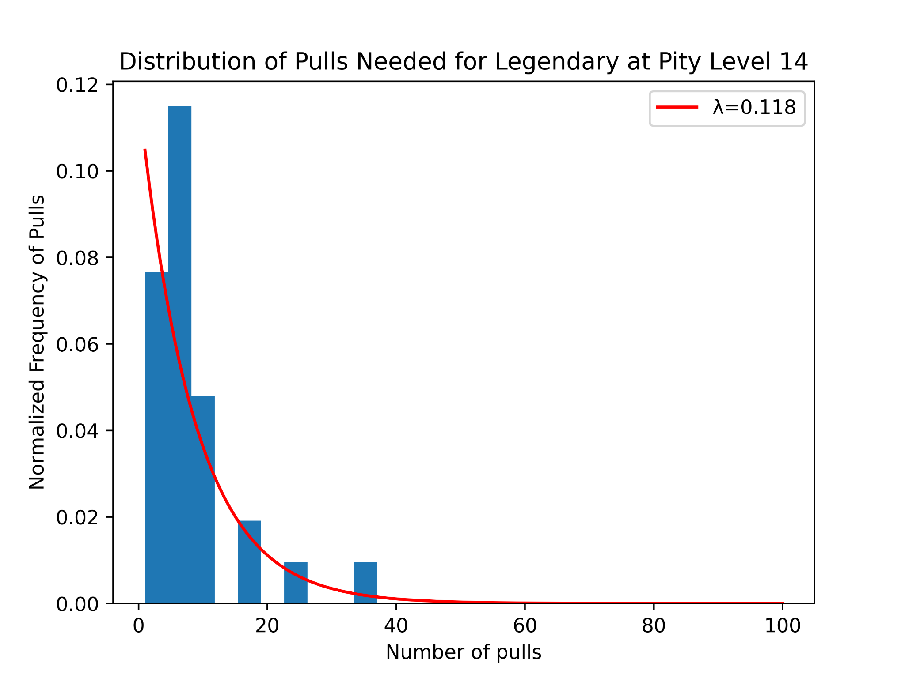
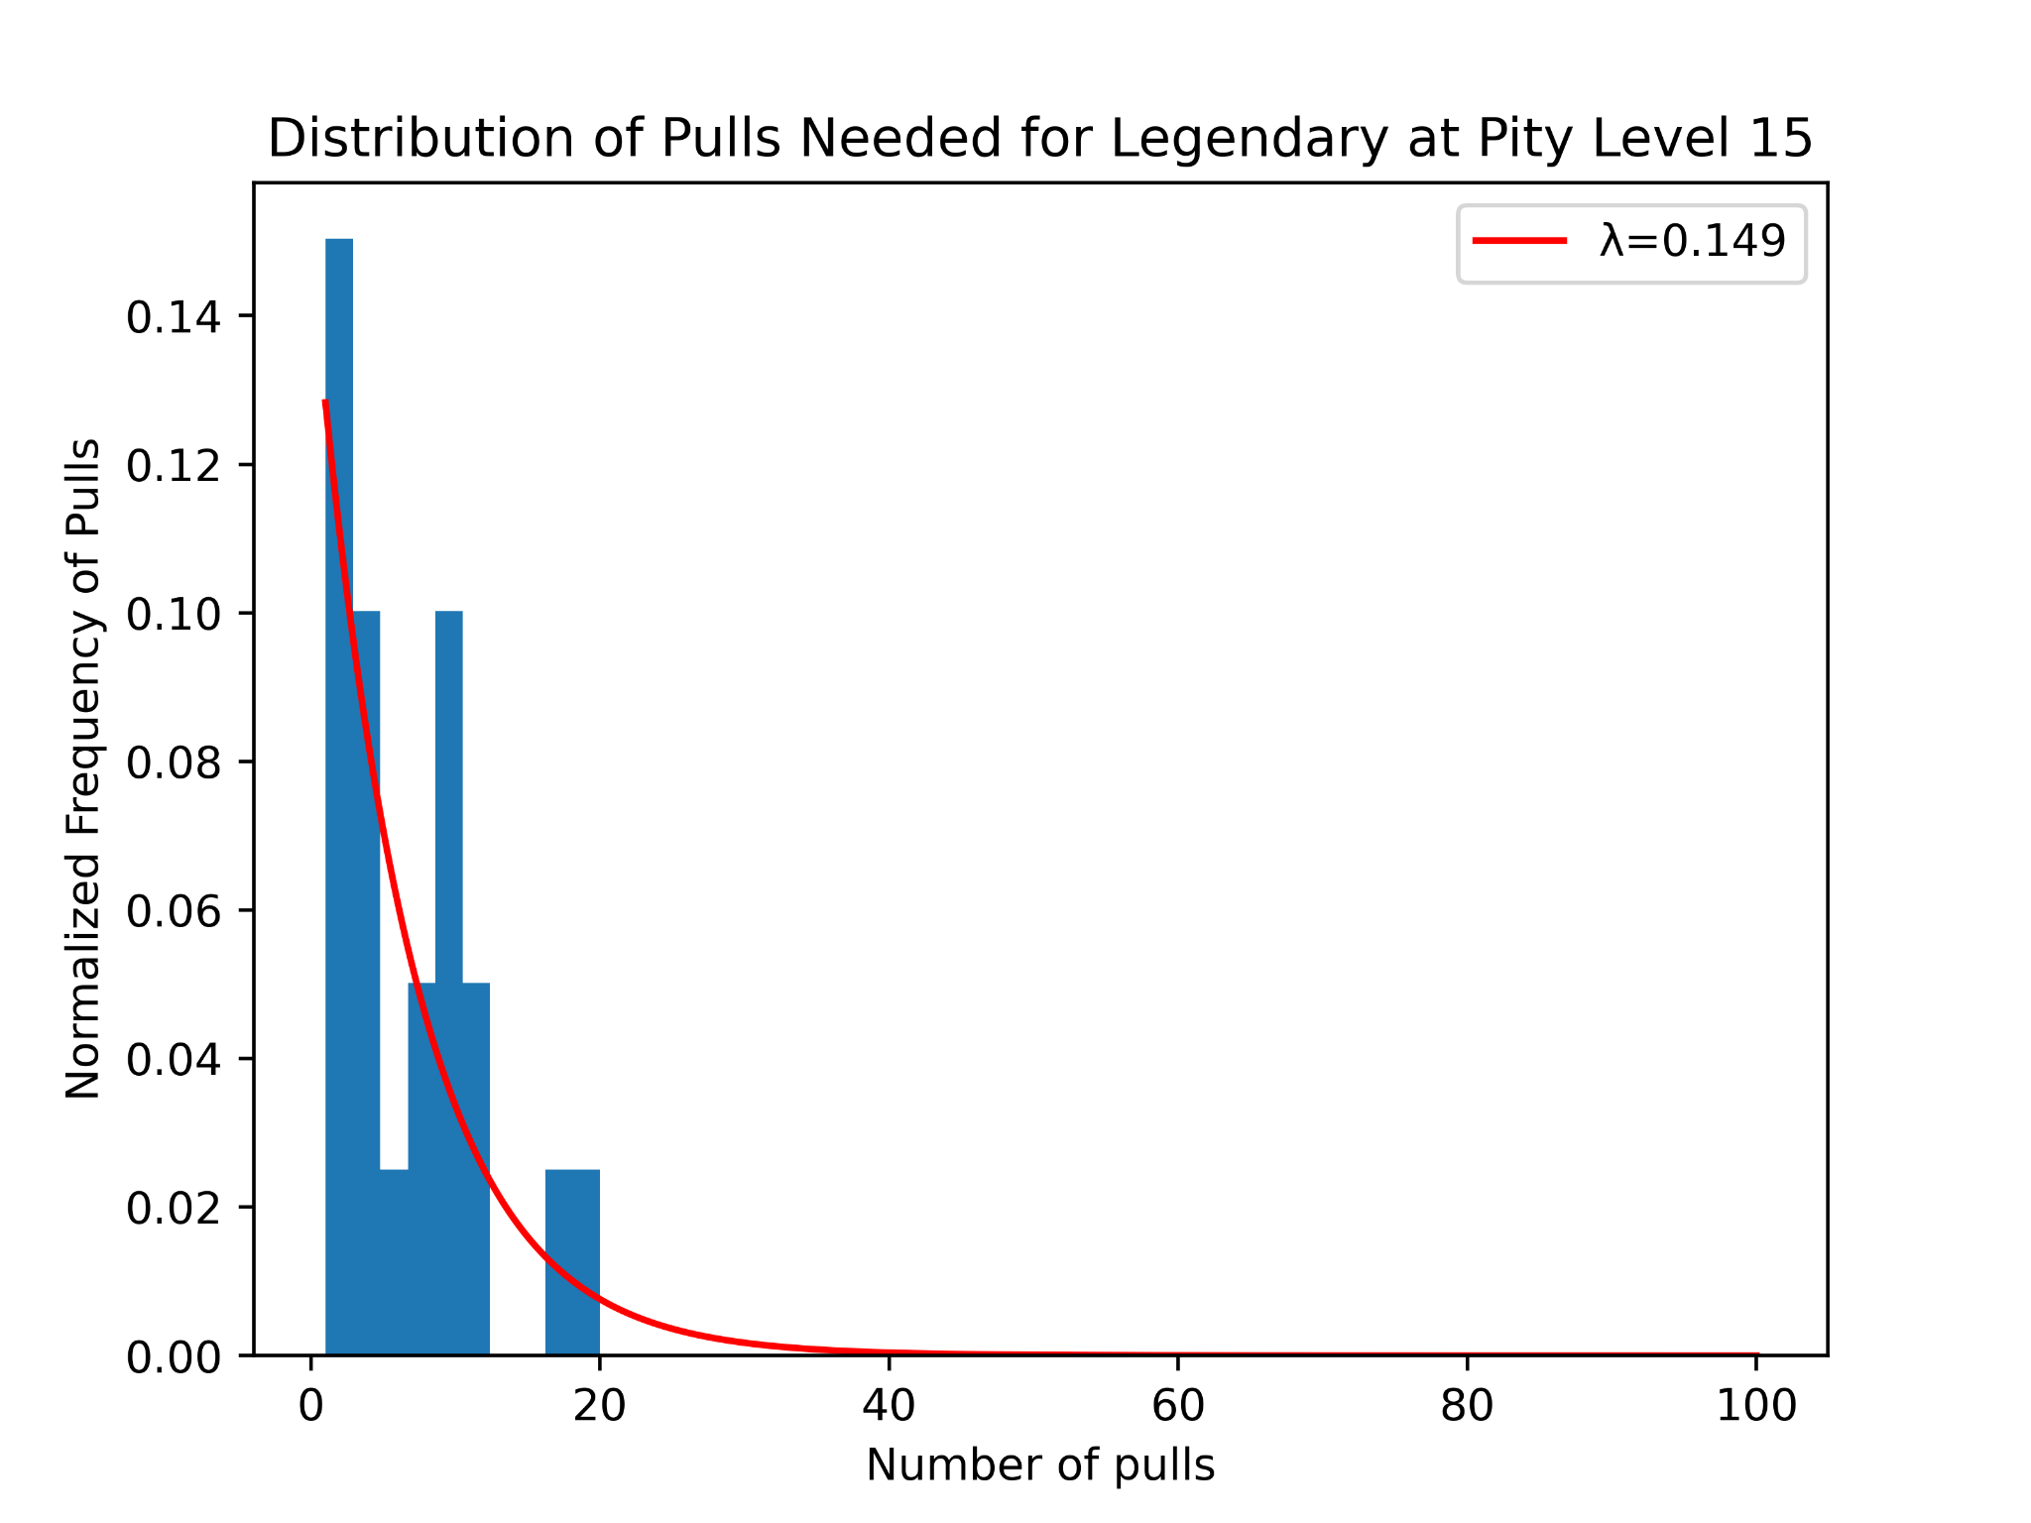
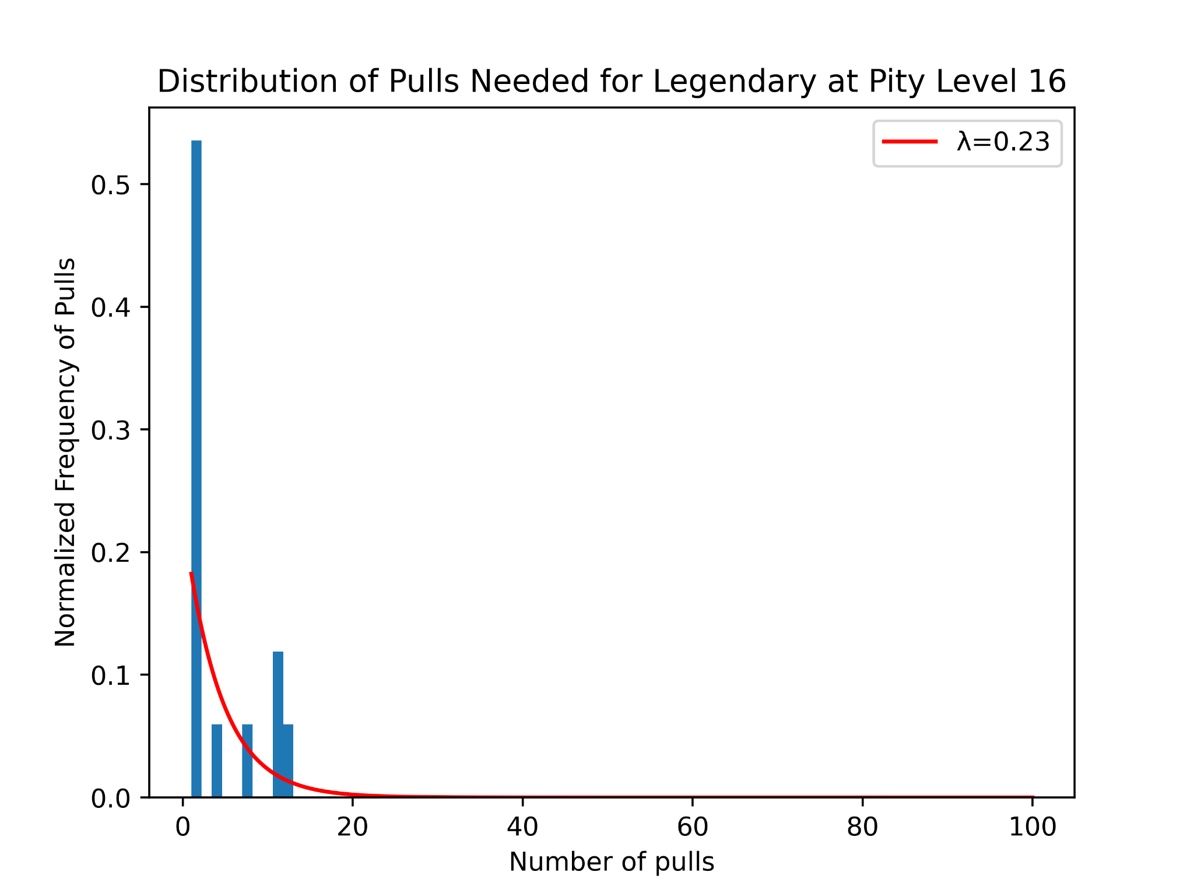
Pulls Needed for Legendary at Given Pity Levels (Cont.)

Slide 15
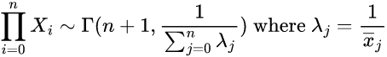
Culmination of these Finding
Parameter Values from Analysis
Random Variable
Distribution of the Random Variables
Product Notation

Slide 16
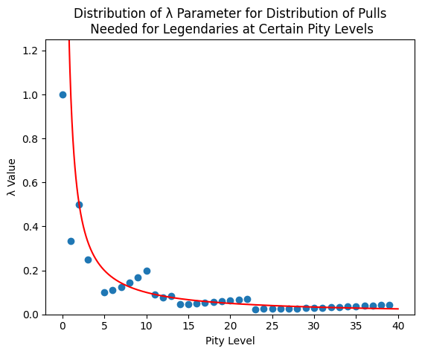
Future Improvements
Try to better understand why λ parameter values for distributions are not monotonically decreasing
Expand our research to include specific characters, weapons, and dates

Slide 17

ANY QUESTIONS??

